Slide 1

Welcome to Everett Public Schools

Slide 2

How many of these facts do you know?

Slide 3

95.9% of students graduate on time!

Slide 4

Everett Public Schools has one of the highest graduation rates in the state.

Slide 5
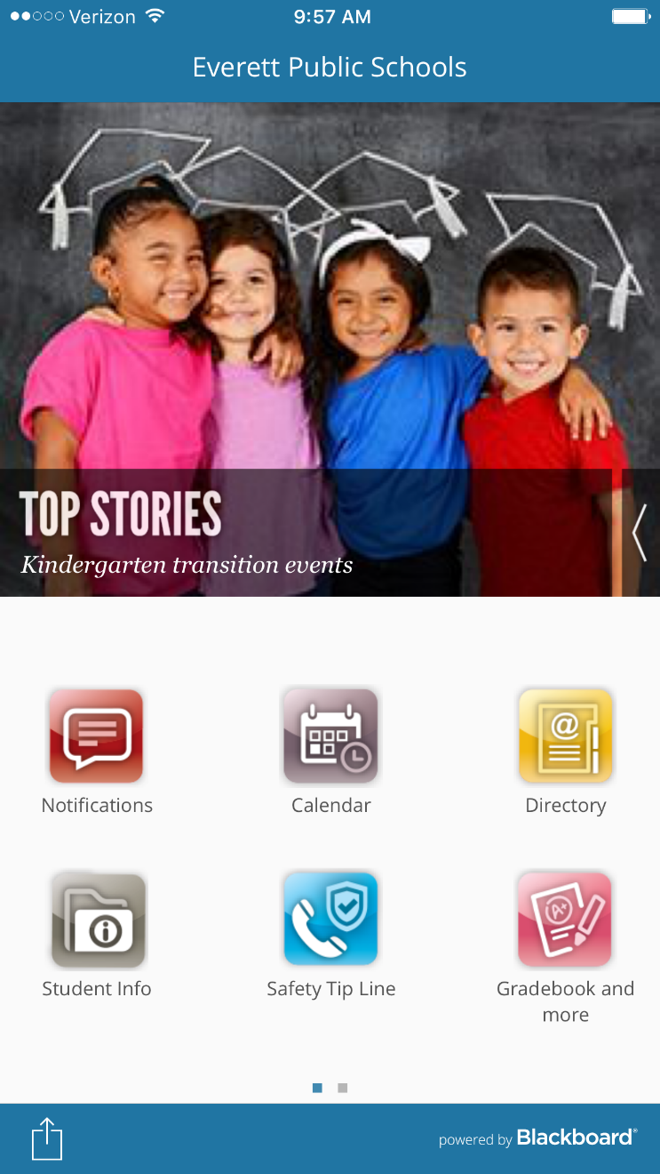
We have
an app!
Search for Everett Public Schools in your app store.

Slide 6

Over 90 languages are spoken by students in Everett Public Schools.

Slide 7
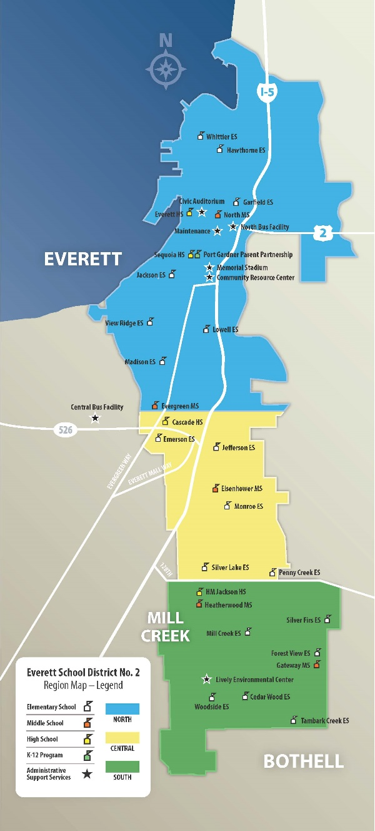
We are one of the fastest growing districts in the county.
Around 20,000 students now, 1,858 more expected by 2026.

Slide 8
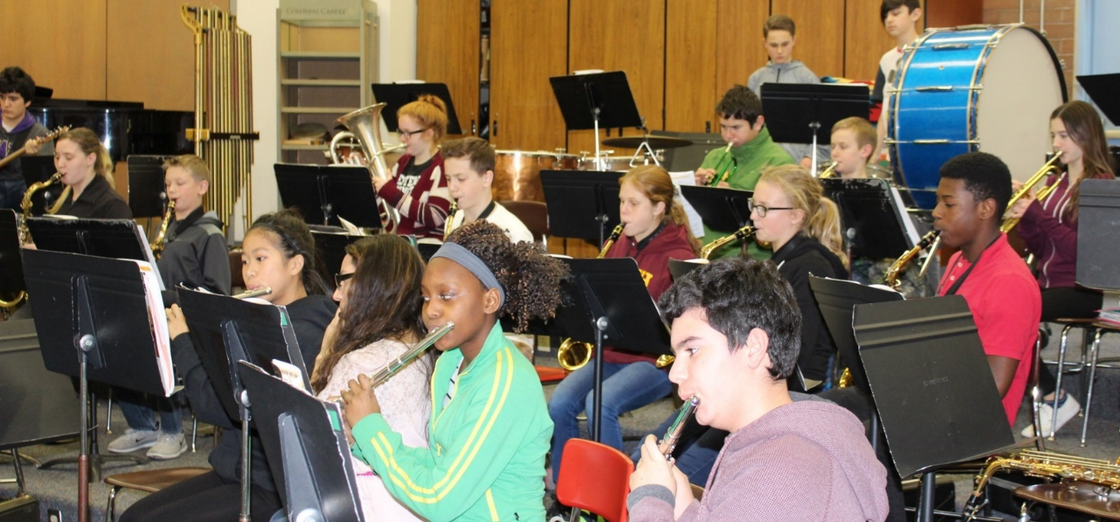
We partner with Music4Life to put gently-used music instruments into the hands of students in district music programs.

Slide 9
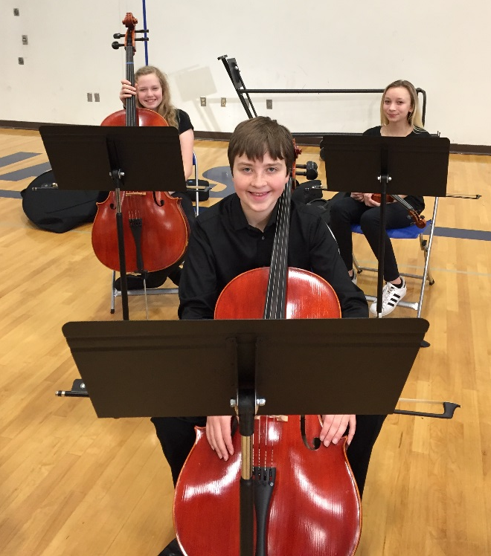
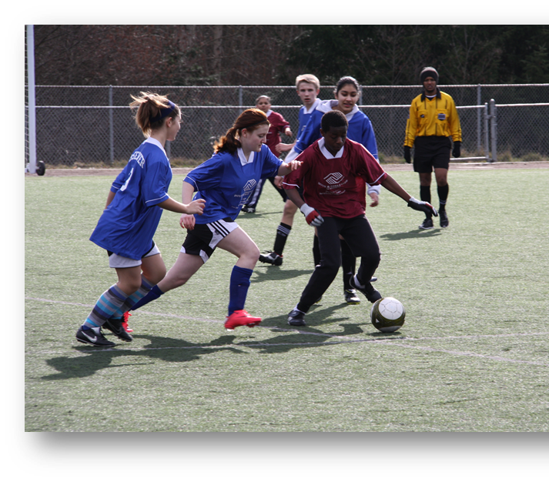
Students’ interests are supported
Orchestra
Performing arts
STEM
Athletics
Activities
One-to-one technology

Slide 10

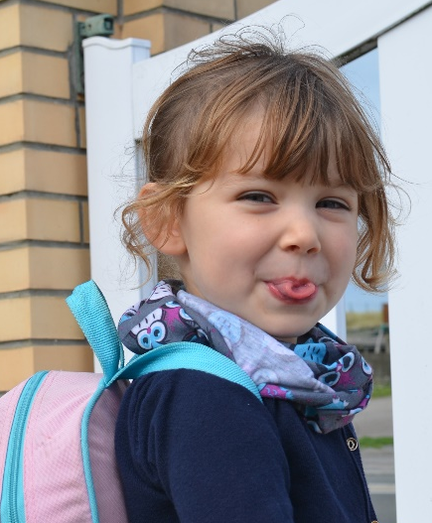

Over 1/3 of EPS students live in poverty
We served 1,469 homeless students last year –
enough to fill over 2 elementary schools

Slide 11
District residents aged 60+ are eligible for free admission to some school sporting and performance events.
Call 425-385-4041 or see our website about the Senior PEP Club.

Slide 12
Assessment scores surpass the state … again!
Difference between percentage of district students meeting standard and the state percentages.
2019 | ELA | Math | Science
Grade 3 | +12.3 | +11.4
Grade 4 | +14.4 | +15.3
Grade 5 | +12.3 | +13.2 | +12.1
Grade 6 | +14.1 | +9.8
Grade 7 | +11.0 | +5.5
Grade 8 | +15.9 | +10.3 | +13.3
Grade 10 | +6.3 | +1.8
Grade 11 |  |  | +2.8

Slide 13
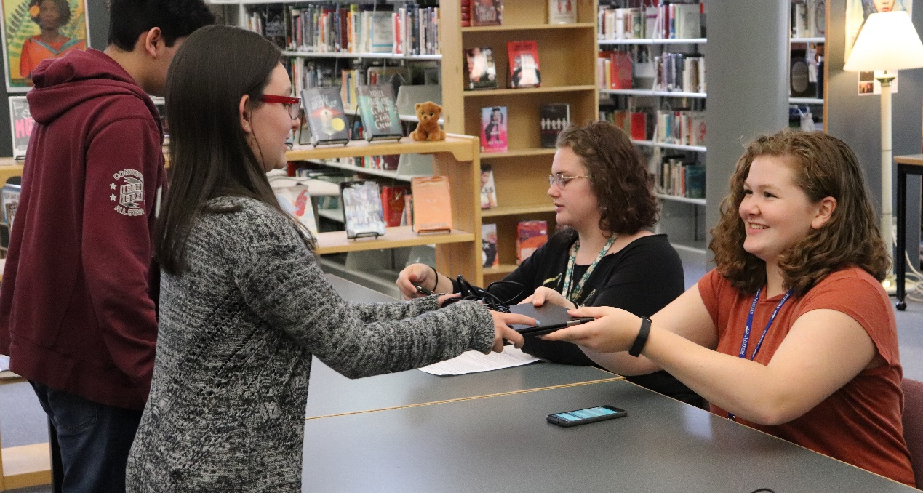
1:1 technology for students continues to roll out

Slide 14
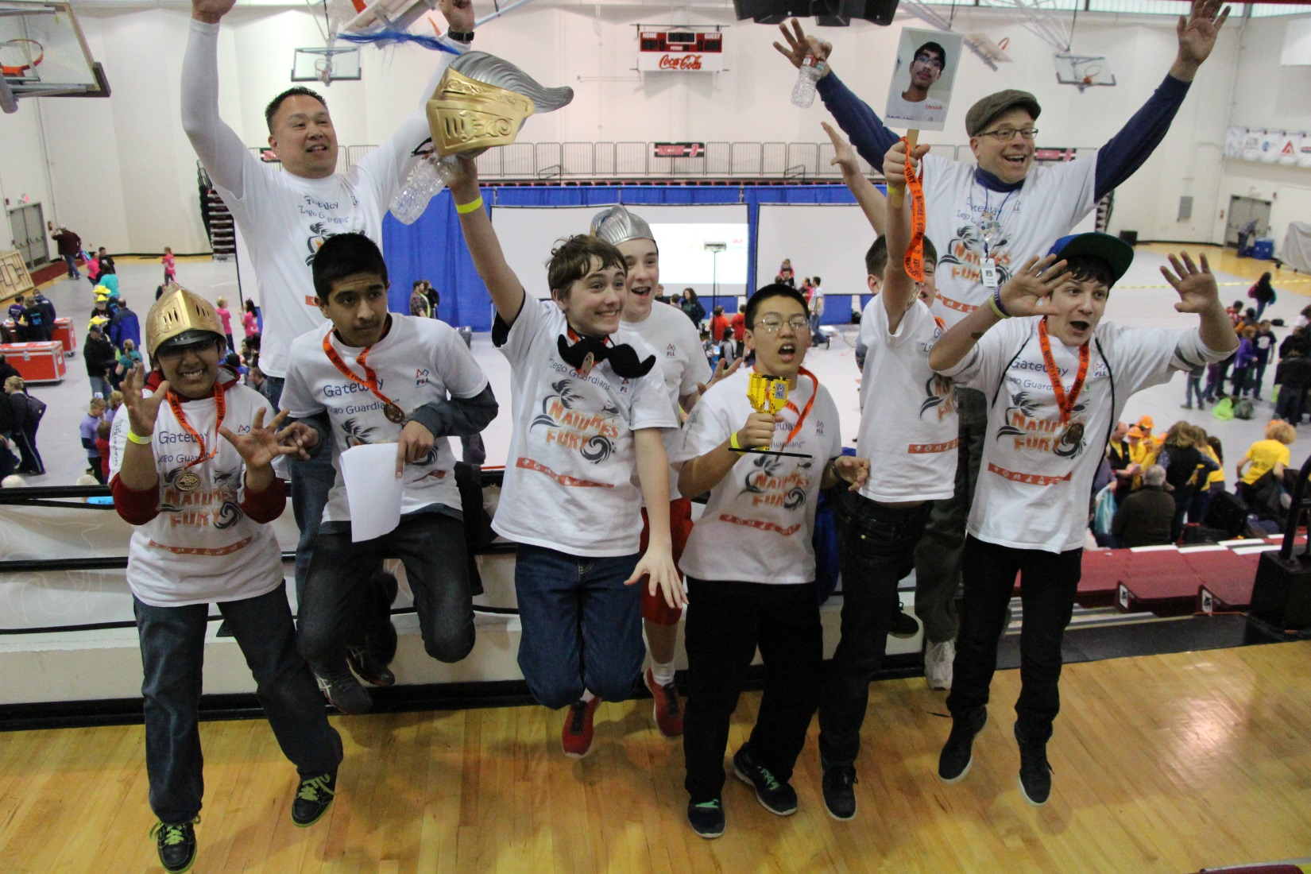
Each school has a robotics program.

Slide 15
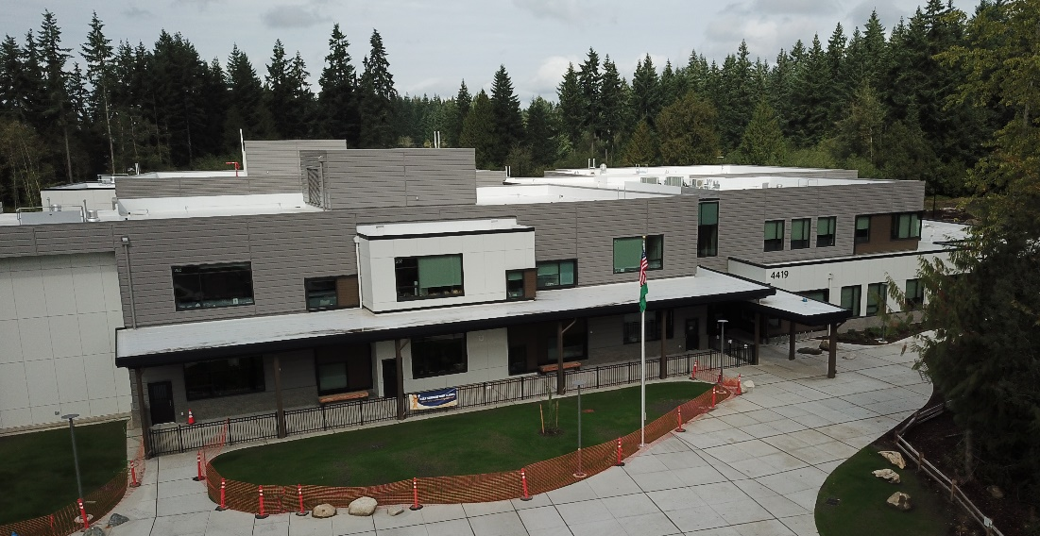

Thanks to the 2016 bond support:
Tambark Creek Elementary opened this fall

Slide 16
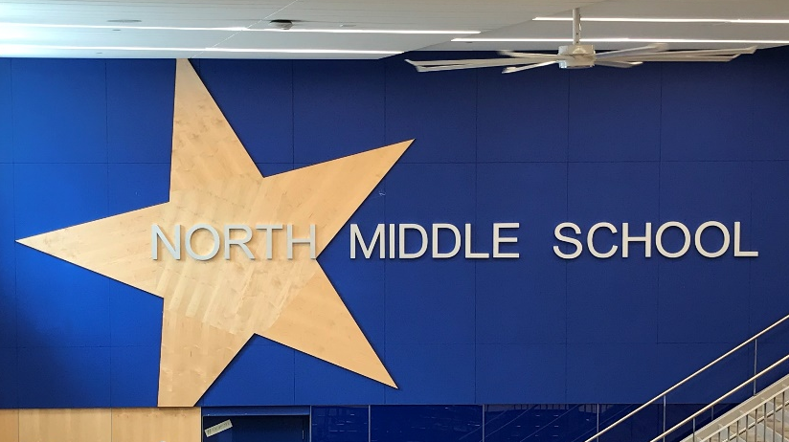
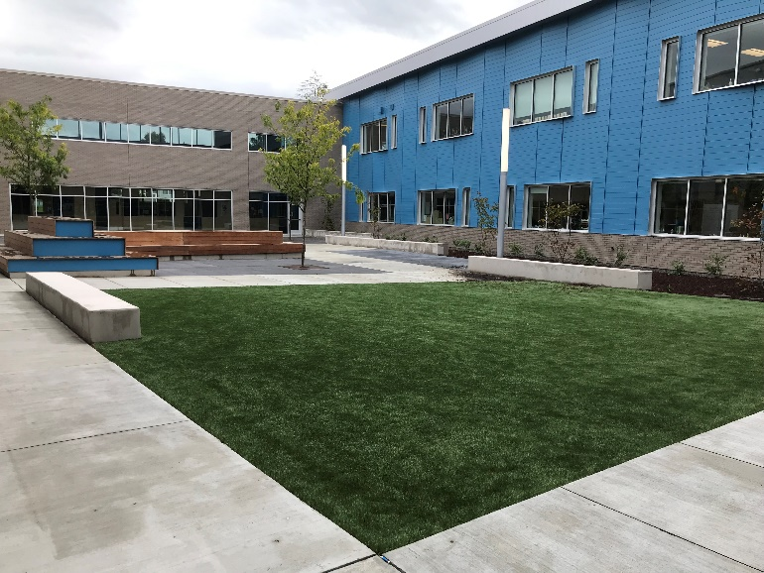
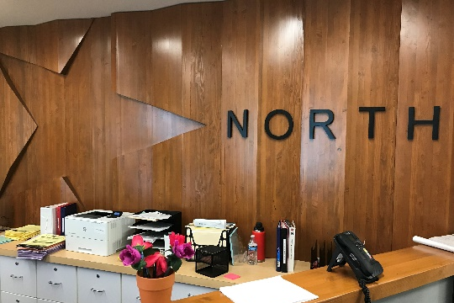
Thanks to the 2016 bond support:
North Middle School modernization – opened this fall to students

Slide 17
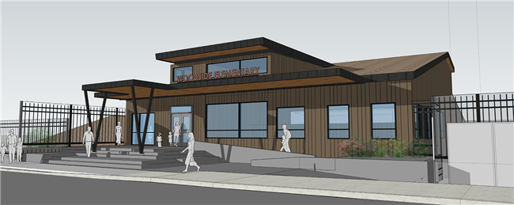
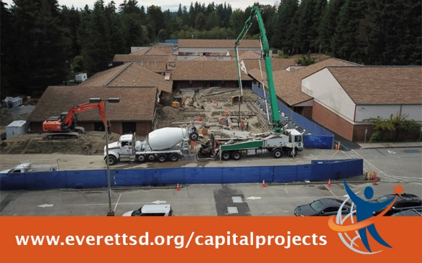
Thanks to the 2016 bond support:
Woodside Elementary modernization project underway

Slide 18
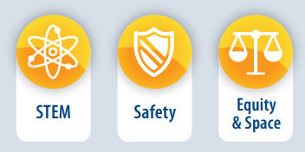
Everett Public Schools is placing a $317.4 million bond on the April 28, 2020 ballot.
2020 Capital Bond Proposal
The 2020 bond focuses on:

Slide 19
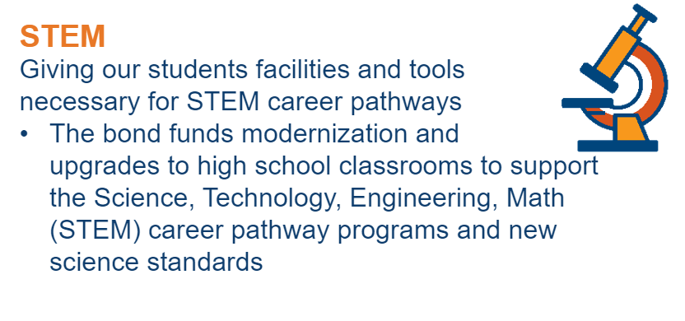

2020 Capital Bond Proposal

Slide 20
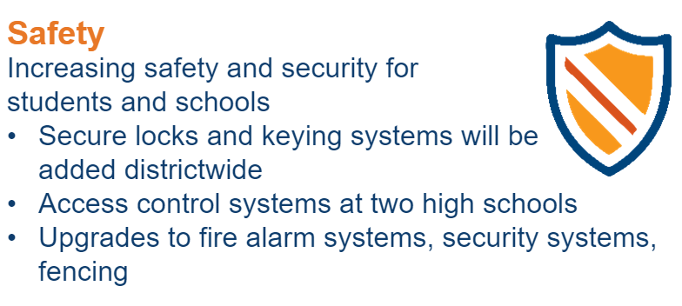
2020 Capital Bond Proposal

Slide 21
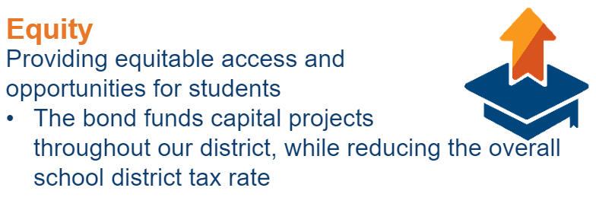
2020 Capital Bond Proposal

Slide 22
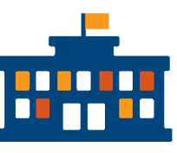
2020 Capital Bond Proposal
Space
Adds 58 new elementary classrooms​
(through additions and replacements) which is equivalent to two elementary schools​
Reduces overcrowding, keeps classes sizes low and keeps more kids in their neighborhood schools​
Repairs aging school systems in our schools like HVAC and roofing and flooring replacement that extend the longevity of schools​

Slide 23
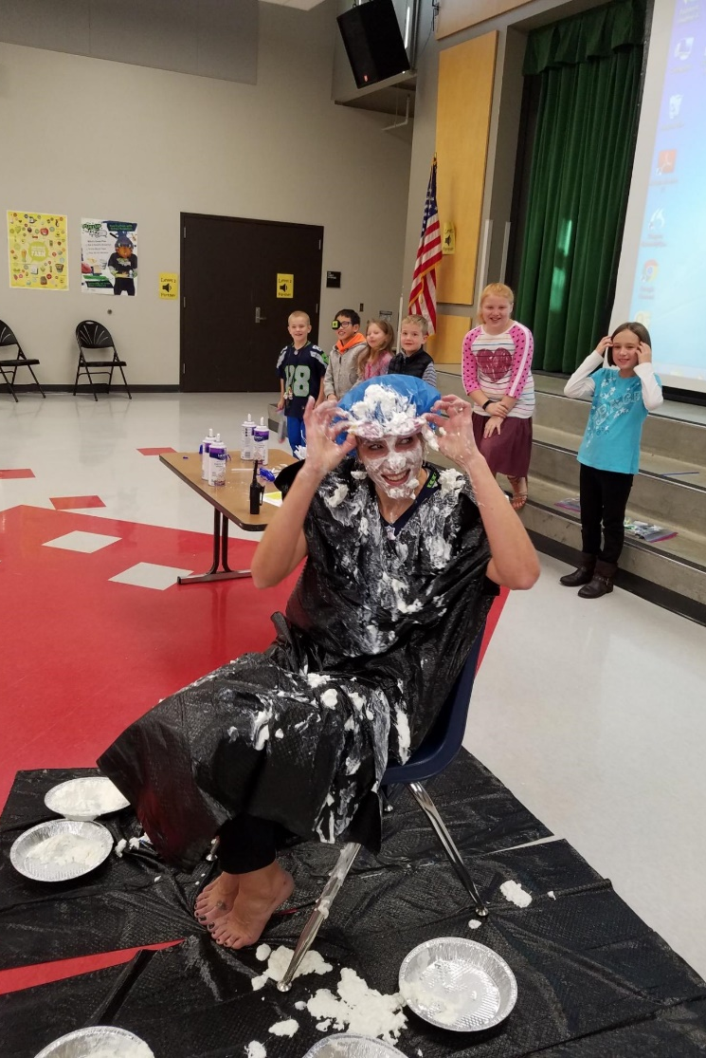
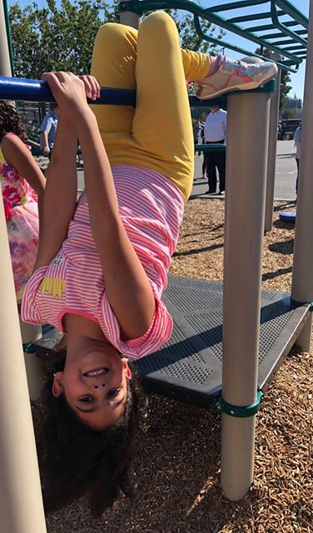
We laugh together … a lot!

Slide 24
Insert a fact about your school
Insert answer here

